Slide 1
MILESTONE 1
GESTURE VOLUME: VOLUME CONTROL WITH HAND GESTURES USING A WEBCAM

Slide 2
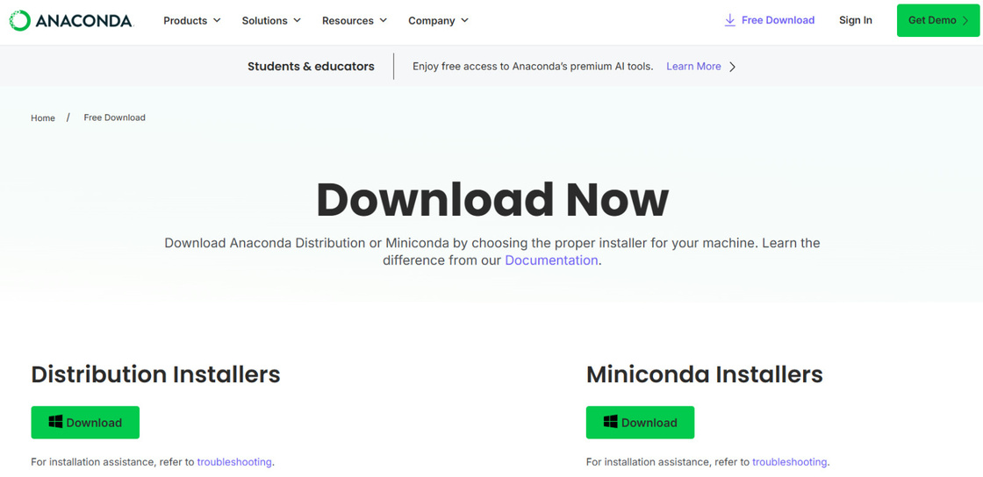
REQUIREMENTS
Anaconda
Per installed/ download it
  MediaPip
  OpenCV
  NumPy
  Matplotlib
  Jupyter notebook
RUN ANACONDA PROMPT

Slide 3
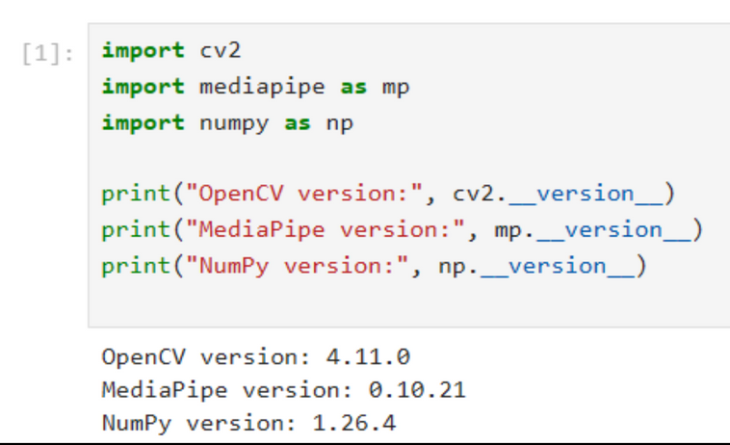
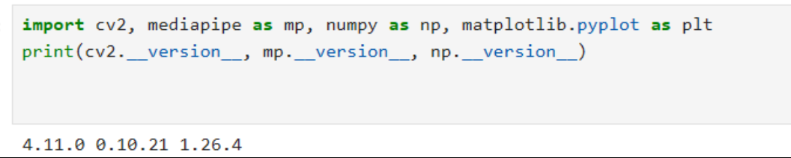
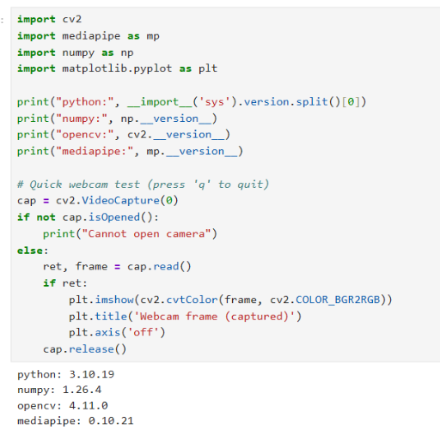
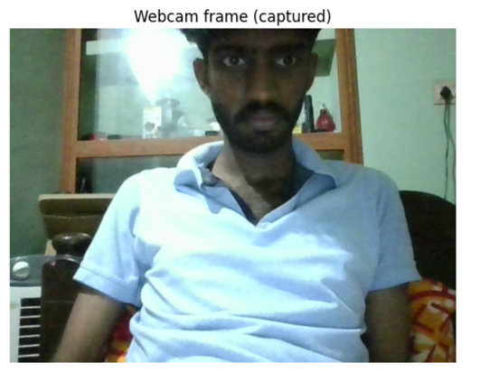

Slide 4
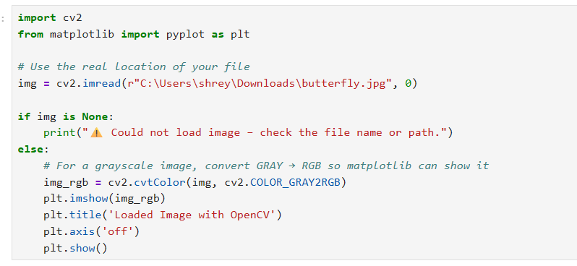
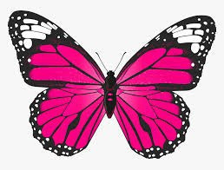
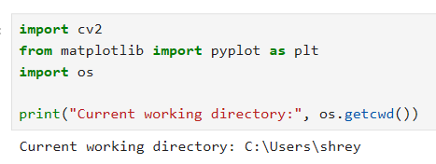
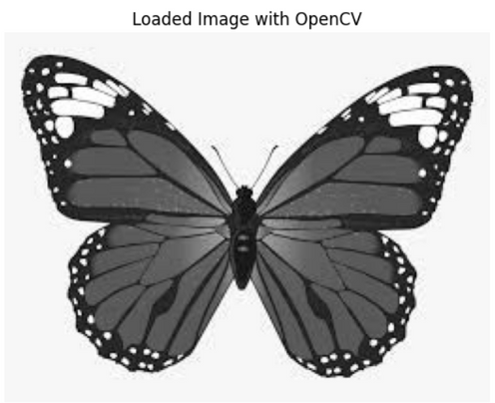

Slide 5
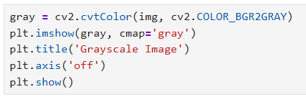
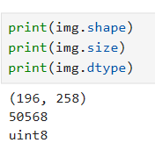
Grayscale Conversion & Display
Purpose: To change a color image into grayscale and show it on the screen.
cv2.cvtColor(...): Converts the image color from BGR (Blue, Green, Red) to GRAY.
plt.imshow(gray, cmap='gray'): Displays the new gray image. The cmap='gray' part is essential to make it render in black and white.

Slide 6
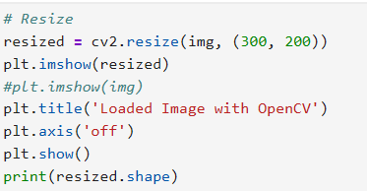
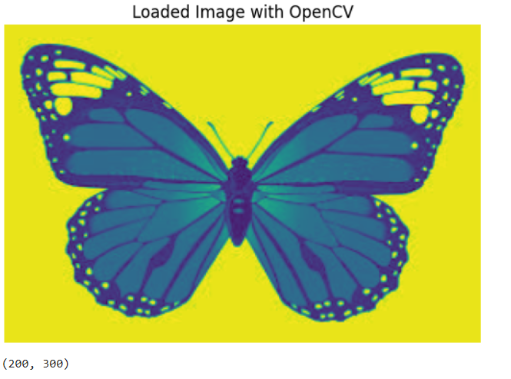
Resize

Slide 7
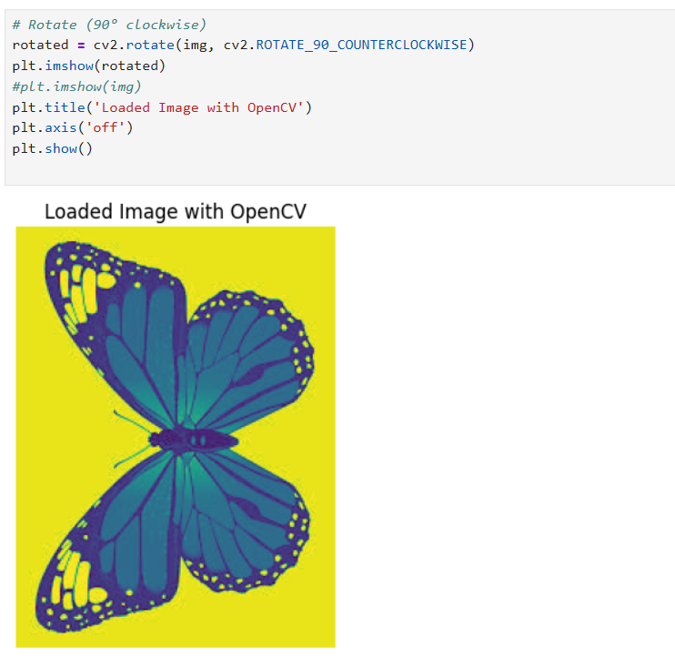
ROTATE 90°

Slide 8
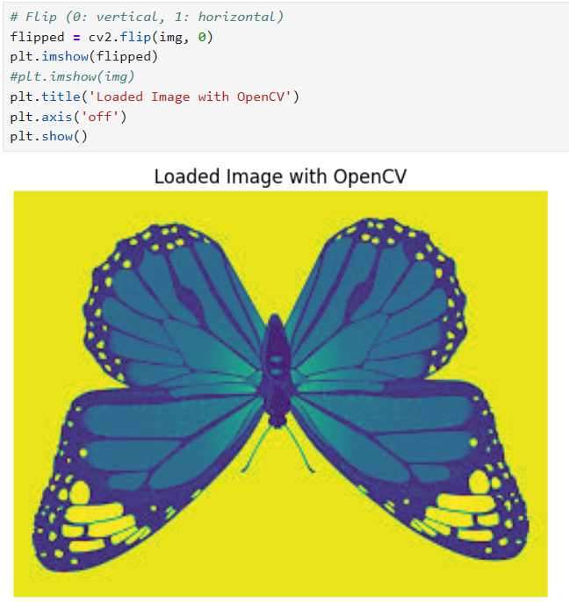
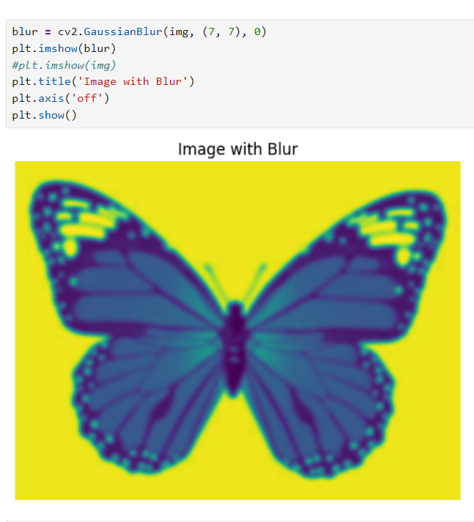
FILPING
Image blurring

Slide 9
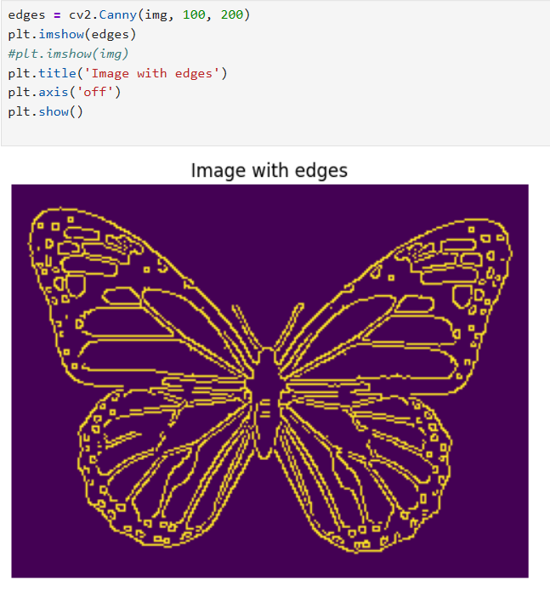
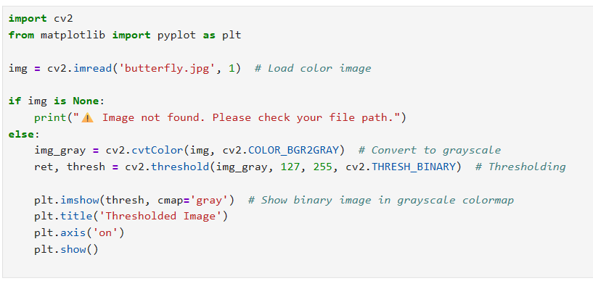
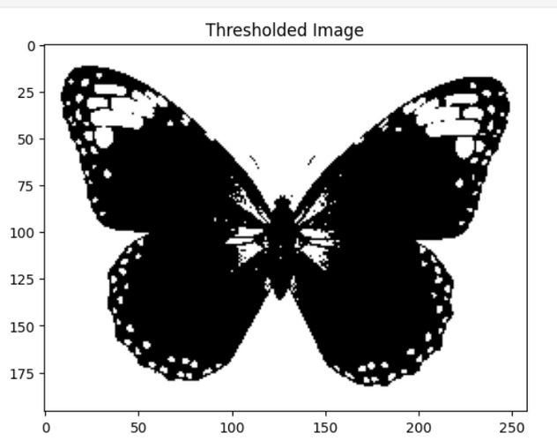
Image with edges
THRESHOLDED IMAGE

Slide 10
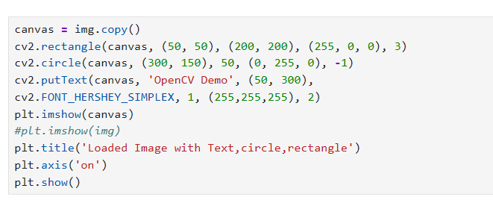
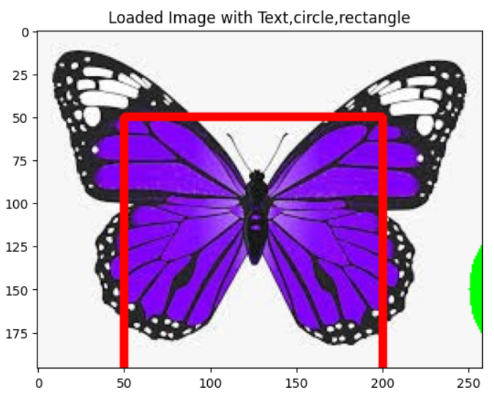

Slide 11
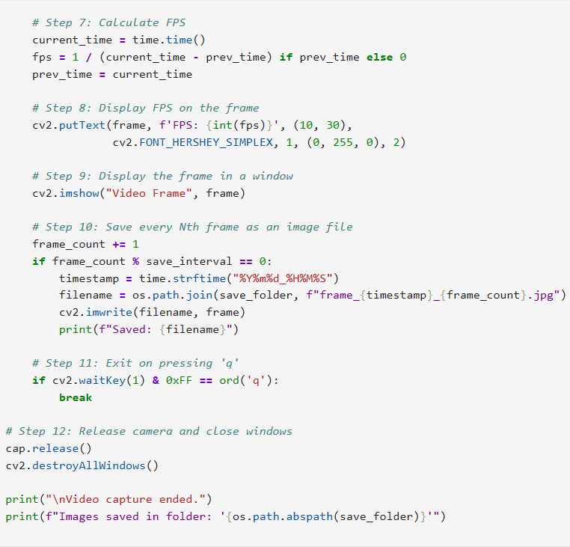
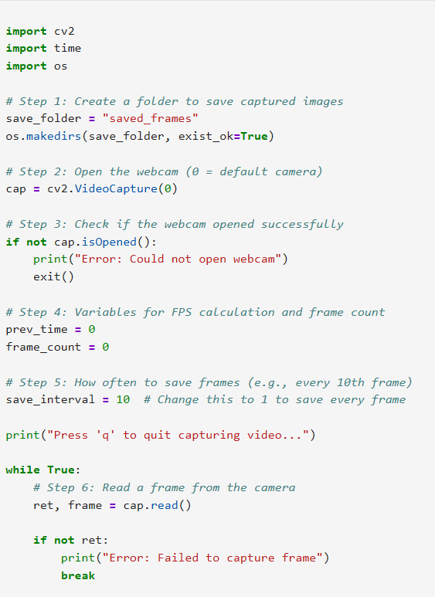

Slide 12
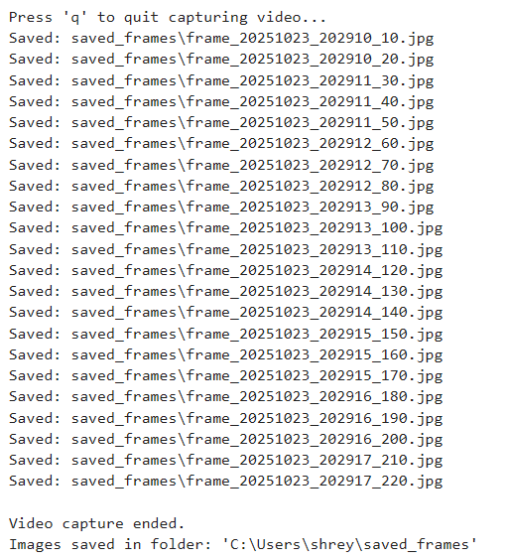

Slide 13
Thank you!

